Slide 1
Every Millisecond Counts
A case study in tuning a Frequent procedure to <1ms duration

Slide 2
Jared Poche
10 year veteran of Microsoft CSS
He/him
Database Engineer
ChannelAdvisor
/jared-poche
@sqljared
sqljared@outlook.com
sqljared.com
Blogger, SQL Saturday and Virtual PASS speaker

Slide 3
Expectations
Intermediate/Advanced level
Not standard query tuning
No missing indexes or table scans
Goals
Attention to detail
Learn code techniques
Wholistic view (think outside the DB)

Slide 4
Foundation AND Topics
Upsert procedures
Table variables (no statistics)
Table valued parameters
Memory optimized table variables
Table spool
Indexed Views
Halloween Problem and Protections

Slide 5
Case study
Inventory Management and Updating Quantity
Updating multiple rows by table valued-parameters
Updates are customer driven
3.1ms average duration
Query Store providing all times
285 million – 350 million executions per day

Slide 6
Procedure outline
Populates a few variables
Checks for item listings
Aggregates listings
Performs an update
Majority of the duration (80%)
Inserts missing rows
Triggers another table

Slide 7
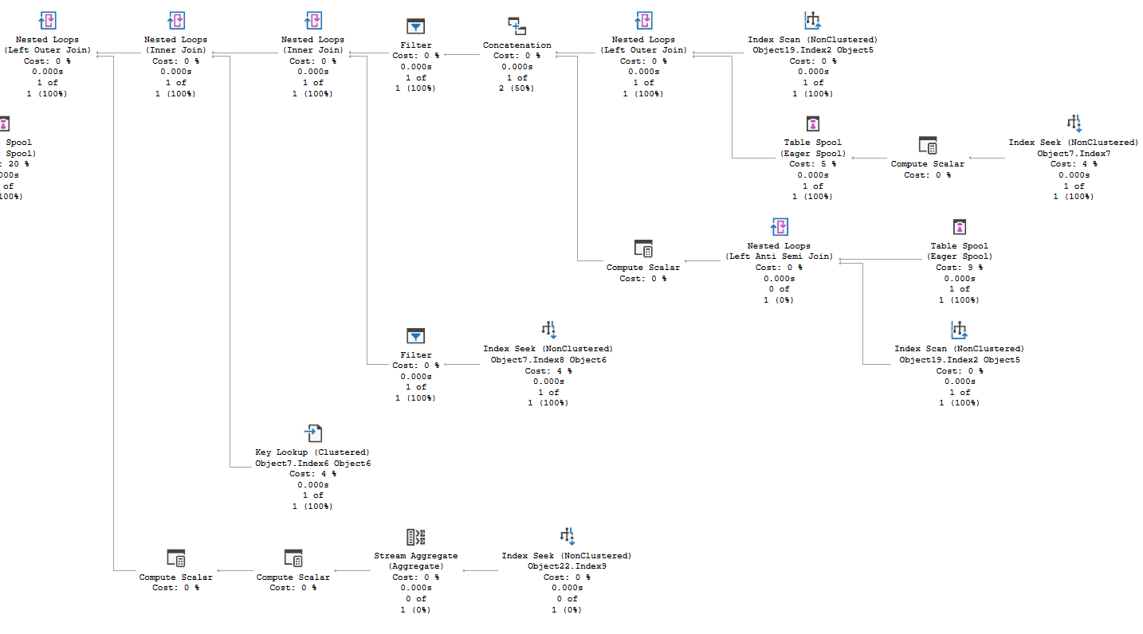
Update Plan: Where’s the issue?

Slide 8
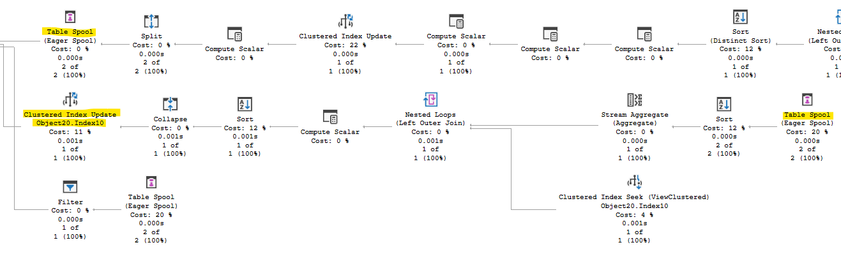
Table Spool?

Slide 9

Ideas
Table Spool\View Updates
Unnecessary INSERTs
Trigger reduction
Table Variables and Cardinality
UPDATE
Key Lookups
Multiple references

Slide 10
Indexed View
Requires a table spool
Updates the view as part of the UPDATE
DML operators much more expensive than a seek
This view is for aggregation
1 row vs 2-5 rows
Reduced duration by 17-25% for the procedure
Expensive, as estimated
Removed the index

Slide 11

Memory Optimized Table Variables
Lack of statistics can lead to bad plans
SQL Server optimizer assumes 1 row
Temp tables have stats
TEMPDB contention
May work in other cases, not will 100s of millions of executions per day!
Memory Optimized: hard to beat
Want specific behavior? Give SQL a hint.

Slide 12
Unnecessary Inserts
In case row doesn’t exist for UPDATE
We will UPDATE many times, INSERT once
INSERT 0 rows, still run the TRIGGER
If we UPDATE x rows, matching TVP
Skip the INSERT statement entirely
350 million executions to 6 million
1.95ms → 1.91ms
14,000 seconds per day
Also reduced trigger executions

Slide 13
Update Exec Plan

Slide 14
Update Statement
Two statements; 1 runs per exec
Redundant aggregate in CTE
Second reference to base table in CTE
Unified CASE logic
Key Lookup
Same two key columns as clustered
Hint to use the clustered PK
~28% duration reduction
0.54ms * 350M = 189,000 sec/day

Slide 15
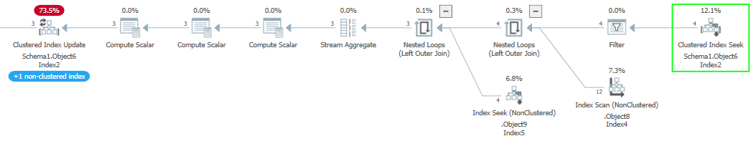
Optimized Update Plan

Slide 16



Mission Accomplished?
Reduced the procedure’s duration from 3.1ms to 1.4ms
Bonus idea: unnecessary UPDATEs
Automated quantity updates repeat values
Limit updates to when quantity really changes
WHERE old.Quantity <> new.Quantity

Slide 17

Halloween Problem
Can affect any DML statement
Don’t try to change the thing you are querying
Prime example
SQL Server optimizer prevents the problem
Changes the plan typically to insert a blocking operator
Bad for performance

Slide 18
Bonus solution
Split the operation
Query the data we need into a temp table memory optimized table variable
Do all the math; get new and old quantity
Check results
If the quantity doesn’t change, skip the UPDATE
Changed INSERT logic
Based on LEFT JOIN instead of @@ROWCOUNT

Slide 19

Too much overhead?
Populating the motv: 90-100 µs
Checking results: 10-20 µs
Skipped > 96% of UPDATES
Final duration: 320 µs

Slide 20
References
Paul White: the Halloween Problem
Aaron Bertrand: Upsert coding patterns
My blogs on Halloween, blocking operators, and this topic
TVPs and memory optimized table variables

Slide 21
@sqljared sqljared.com

